Slide 1
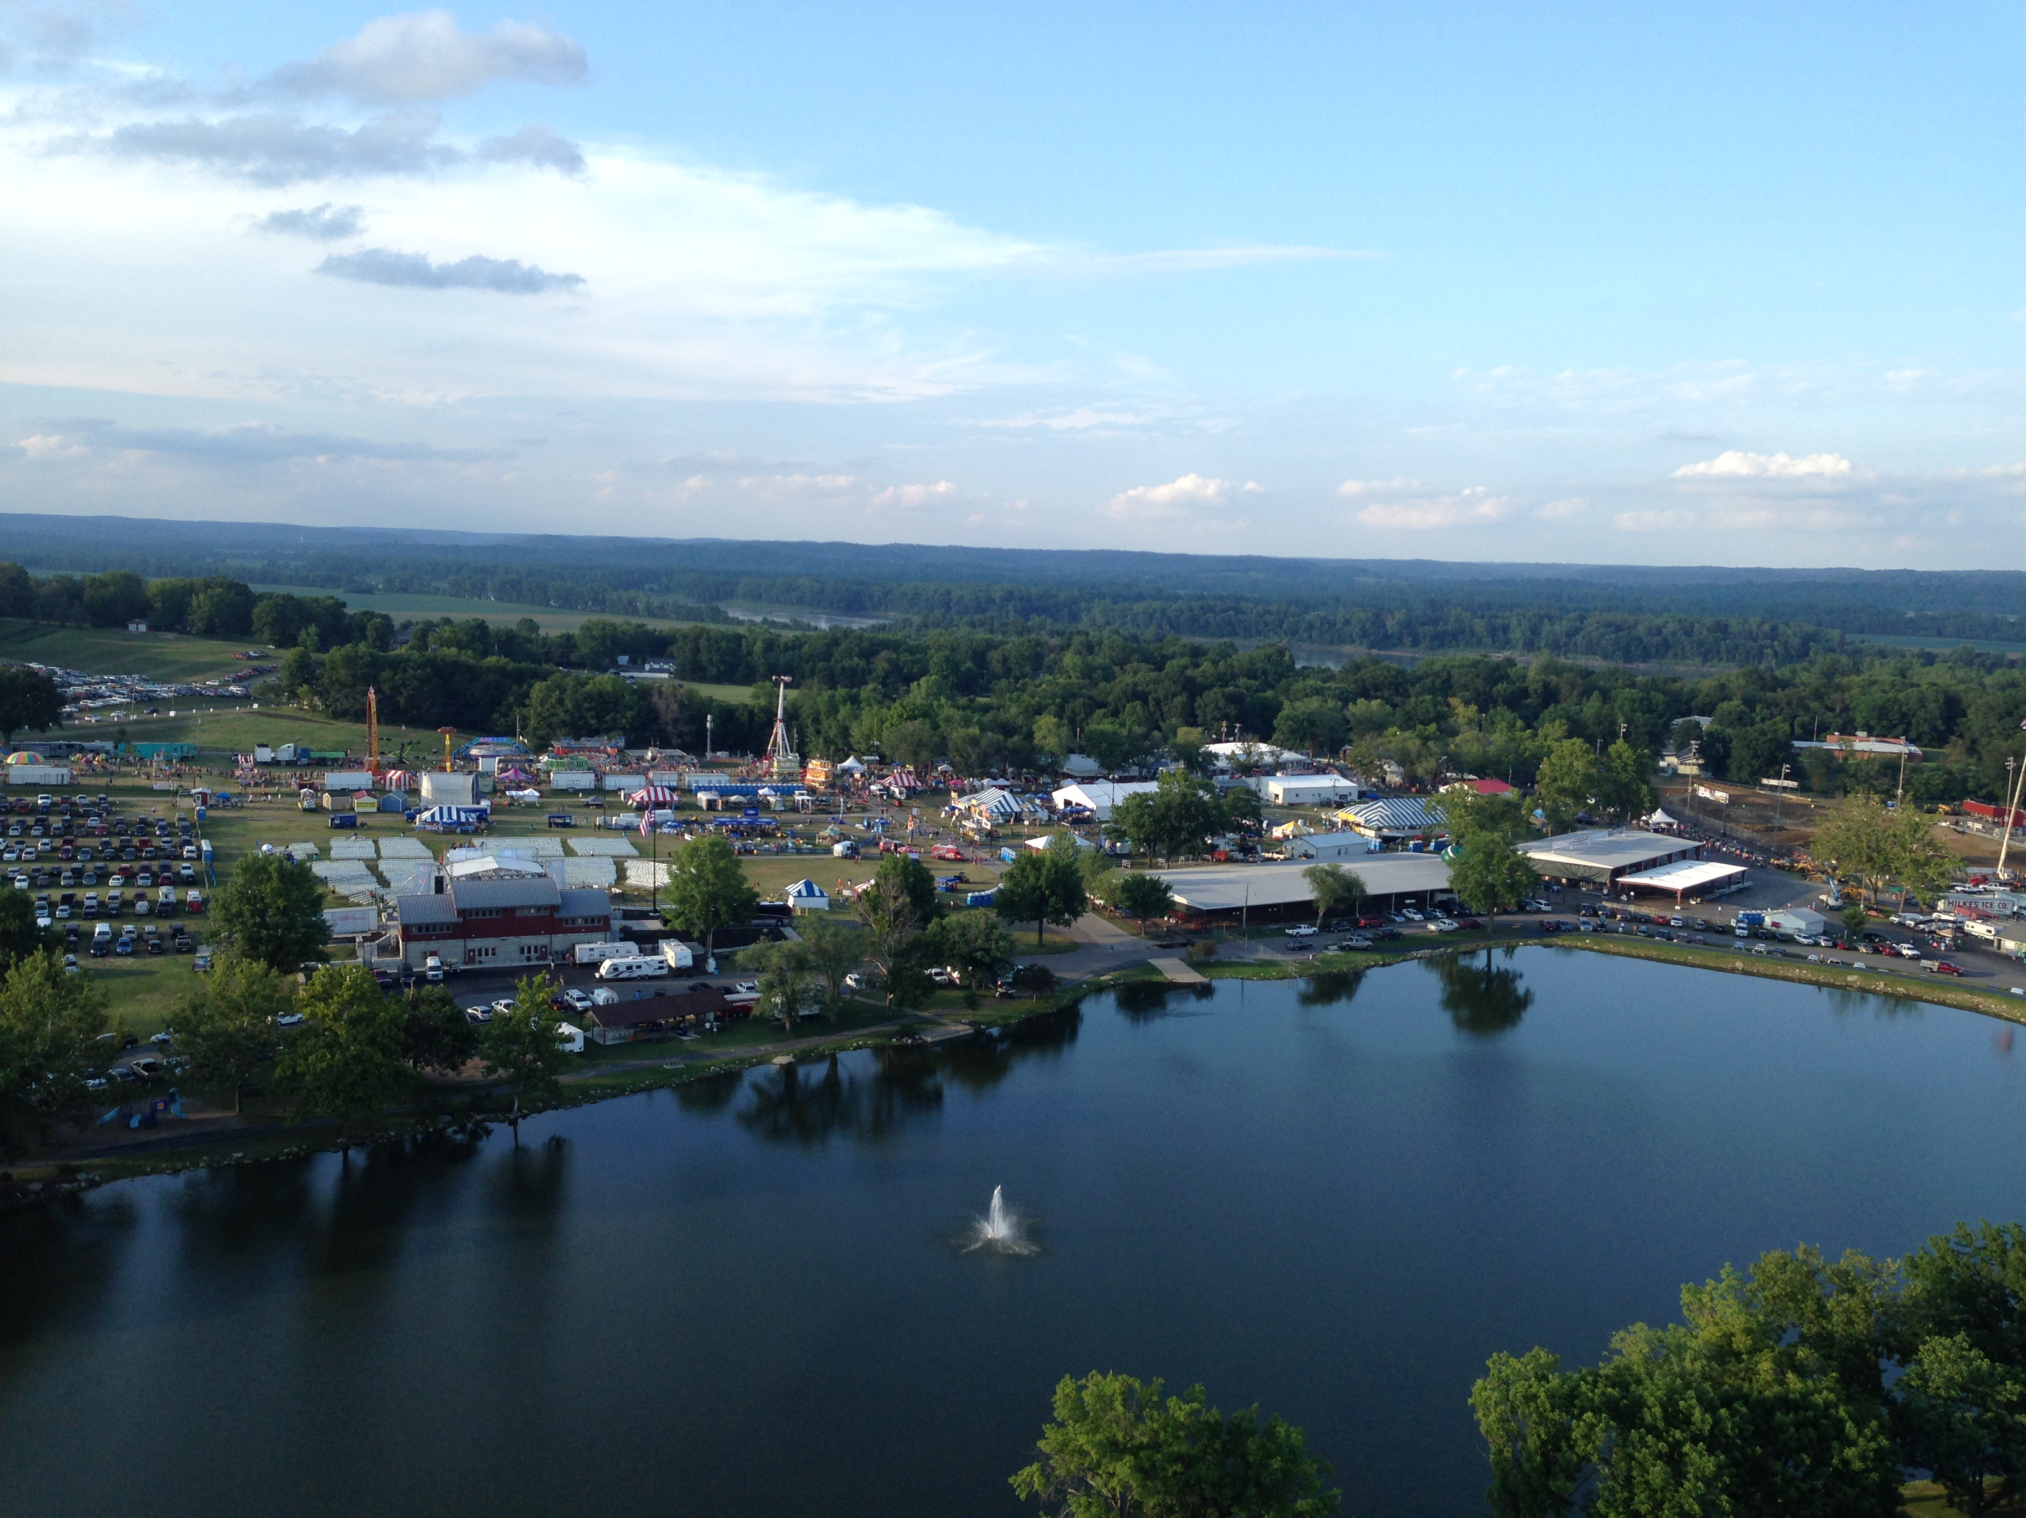
Working With Volunteers From Different Generations
Jennifer Giesike, CFE | Washington Town & Country Fair

Slide 2
Age-related Generations
1929-1945 ➔ The Silent Generation
1946-1964 ➔ Baby Boomers
1965-1980 ➔ Generation X
1981-1996 ➔ Millennials
1997-2009 ➔ Generation Z
2010-2025 ➔ Generation Alpha

Slide 3
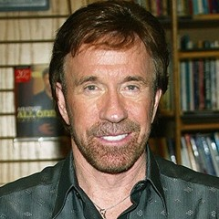
The Silent Generation Born 1929-1945
Characteristics:
Successful
Considerate
Inclusive
Mentors – quiet but industrious
Cautious
Sandwiched – underestimated/overlooked
Values:
Self-reliance
Thriftiness
Hard work/discipline
Dedication/loyalty
Family/community

Slide 4
The Silent Generation
Motivation to Volunteer
Unselfish motivation
Following the example set by parents
Sense of being needed
Hindrance to Volunteering
Time conflicts/lack of flexibility
Unclear objectives
Health
Motivation to continue with Volunteering Efforts
Help fair to survive
Socialization
Feel needed – an asset to the fair

Slide 5
The Silent Generation cont’d
Actions you can change or improve to ensure continued Volunteerism
Expand the volunteer base
Clear communication
Most important factors in retaining Volunteers
Making it worthwhile
Sense of accomplishment

Slide 6
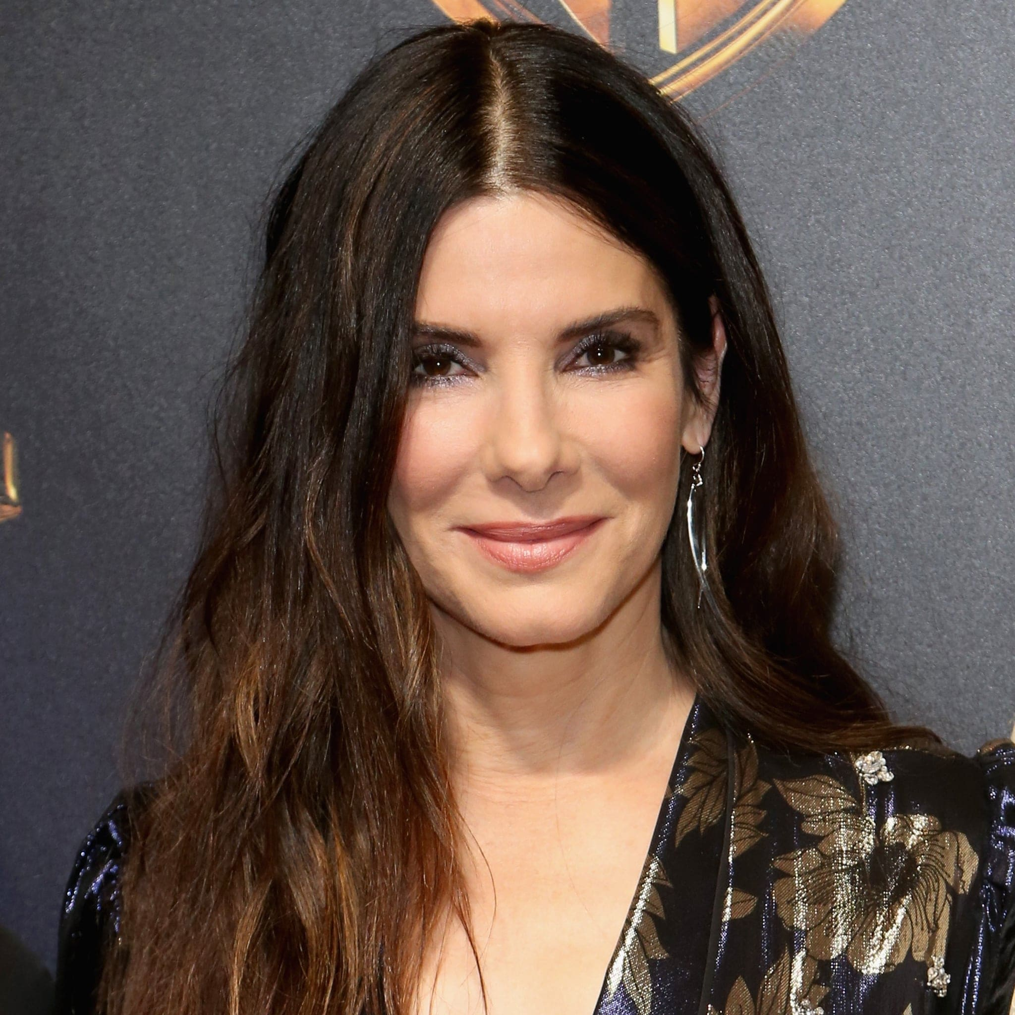
Baby Boomers Born 1946-1964
Characteristics:
Educated
Independent
Desire quality
Cause-oriented
Fitness conscious
Question authority
Resourceful
Values:
Work
Personal gratification
Focus on self
Health/youthfulness
Competitive

Slide 7
Baby Boomers
Motivation to Volunteer
Active aging
Unselfish motivation
Address a need at the fair
Sense of accomplishment, wellbeing and belonging
Passing on skills
Hindrance to Volunteering
Time conflicts/lack of flexibility
Lack of organizational structure and vision
Poor treatment of volunteers
Motivation to continue with Volunteering Efforts
Sense of accomplishment, wellbeing and belonging
Tasks that are less physically-demanding
Feel needed and appreciated
Their talents and skills are beneficial to the fair

Slide 8
Baby Boomers, cont’d
Actions you can change or improve to ensure continued Volunteerism
Appreciation for volunteer efforts
Expand the volunteer base
Clear communication
Most important factors in retaining Volunteers
Appreciation for their efforts
Sense of accomplishment
Flexibility with time demands
Adult learning opportunities

Slide 9
Generation X Born 1965-1980
Characteristics:
Independent
Flexible
Self-Reliant
Results-Oriented
Critical Thinkers
Entrepreneurs
Serious about life
Values:
Work-life balance
Diversity
Highly educated
Technologically savvy
Fun
Informality

Slide 10
Generation X
Motivation to Volunteer
Unselfish motivation
To be involved with fair, meeting new people
Being involved with their children
Focus on a meaningful cause
Hindrance to Volunteering
Time conflicts due to family and work
People with negative attitudes toward others
Motivation to continue with Volunteering Efforts
Continue to help the fair
Being involved in their children’s activities
Enjoy the people they volunteer with
Flexibility in volunteering requirements
Volunteering through employer

Slide 11
Generation X cont’d
Actions you can change or improve to ensure continued Volunteerism
Communicate frequently with volunteers
Expand the volunteer base
Most important factors in retaining Volunteers
Appreciation for the efforts of the group
Sense of accomplishment
Interesting Fact: Generation X want to give back and have the highest volunteer rate of any generation. They also are the age group the contributes the most in donations.

Slide 12
Millennials Born 1991-1996
Characteristics:
Open minded
Confident
Short attention span
Overscheduled (busy)
Optimistic/idealistic
Multitaskers
Values:
Civic Engagement
Education
Confidence
Achievement
Diversity
Technologically Savvy

Slide 13
Millennials
Motivation to Volunteer
Selfish motivation
Material gains and new skills
Working with friends and relatives
Giving back, sense of community
Hindrance to Volunteering
Time conflicts/lack of flexibility
Personal conflict with other volunteers
Motivation to continue with Volunteering Efforts
Enjoyment of the work
Enjoy the people they work with and those they help
Being part of the process instead of telling them what the process is

Slide 14
Millennials, cont’d
Actions you can change or improve to ensure continued Volunteerism
Flexibility
Be respectful and caring
Most important factors in retaining Volunteers
Appreciation for their efforts
Worthwhile purpose
Comfortable environment

Slide 15
Generation Z Born 1997-2009
Characteristics:
Diversity
First Digital Natives
Financially-minded
Work Independently
Connected
Entrepreneurs
Values:
Independent
Financially successful
Flexible
Caring
Creative
Technologically savvy

Slide 16
Generation Z
Motivation to Volunteer
Passionate to volunteer
Career skills and learning
Care about making the world a better place
Giving back
Hindrance to Volunteering
Time conflicts/lack of flexibility
Freedom to choose what they want to do
Too controlling
Motivation to continue with Volunteering Efforts
Gain knowledge and skills for future career objectives – resume builder
To have fun

Slide 17
Generation Z cont’d
Actions you can change or improve to ensure continued Volunteerism
Keep everything simple and concise
Tell your story
Leverage social media
Most important factors in retaining Volunteers
Be flexible
Social awareness
Being part of a team

Slide 18
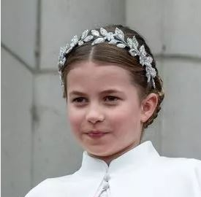
Generation Alpha Born 2010-2025
Characteristics:
Diversity
Focused on Family & Future
Inclusive
Most Educated in generation history
Social Media is mode of interaction
Values:
Honesty
Individuality
Exploration
Goal-Oriented Achiever
Technologically Savvy

Slide 19
Generation Alpha
Rise with expectation of doing good in the world.
Volunteering at school and starting to within their community.
They will make a difference in their communities and will truly live up to their potential.

Slide 20
Now what do we do with all of this information?
What areas do we need volunteers?
How do we find our volunteers?

Slide 21
The Silent Generation Where can you find them?
Civic and social clubs
Shopping centers/supermarkets
Daytime hours
AARP and post-career centers
Faith communities
Senior centers

Slide 22
Baby Boomers Where can you find them?
High-profile media/technology (LinkedIn, Facebook, Online newspapers
Corporations and business associations
Outplacement agencies
Civic organizations
Fitness/wellness centers

Slide 23
Generation X Where can you find them?
Internet (social networking sites, bulletin boards, websites, email)
Fliers: cafes, coffee shops, book stores, gas stations, children’s school events
Graduate schools
Ads at child-care centers where their children attend
Ads at pediatricians’ office
Wellness centers and events

Slide 24
Millennials Where can you find them?
Young professional groups, civic engagement clubs
Fitness/wellness centers
Media: Internet sites, social networks, radio, text requests
College campuses
Peer-to-peer recruitment

Slide 25
Generation Z Where can you find them?
Social networks (TikTok, Snapchat, Instagram, Twitter)
Social impact groups
Fliers: coffee shops, cafes, book stores
Vintage shops
College campuses
High school campuses
Word of mouth

Slide 26
Generation Alpha Where can you find them?
Elementary School
Middle School

Slide 27
How do you communicate with them?
The Silent Generation
Simple and straightforward; letters, phone
Baby Boomers
Personal style to build rapport; phone, face-to-face networking
Generation X
Direct approach; email, voicemail, social media platforms
Millennials
Social networking websites, texts, expect instant feedback
Generation Z
Social media platforms, texts, expect instant feedback
Generation Alpha
Social media platforms, expect instant feedback

Slide 28
Recommendations for working with all volunteers!
Make volunteering a social affair. Provide networking opportunities.
Demonstrate a need for volunteers. Be vocal. Volunteer position descriptions are key.
Manage your volunteer events professionally.
Treat volunteers with respect, make them feel welcome, avoid gossip and negativity at all costs.
Offer numerous times or ways to volunteer to alleviate issues; work and family conflicts.
Let current volunteers know they are needed and have made a difference. Recognition is important!
Make the volunteer experience fun!

Slide 29
In Summary
Different generations bring different strengths, beliefs and attitudes.
Utilizing your volunteers’ generational assets can have a positive impact on the climate and overall success of your organization.

Slide 30
Thank you!
Jennifer Giesike, CFE
Washington Town & Country Fair
Washington, Missouri
636-239-2715 ext. 104
jgiesike@washmo.org

